Slide 1

SOKOINE UNIVERSITY OF AGRICULTURE
School of Engineering and Technology | Department of Agricultural Engineering
AEN 214: INTRODUCTION TO ELECTRONICS — LECTURE 2
Semiconductor Physics
Band Theory, Carrier Transport, PN Junctions & Hall Effect Transducers
Course Instructor: Dr. Kadeghe Goodluck Fue, PhD, P.Eng (T)
Electronics & Precision Agriculture Laboratory | Academic Year 2025/2026 | Sokoine University of Agriculture
Sokoine University of Agriculture | School of Engineering & Technology | Department of Agricultural Engineering
Slide 1 of 26

Slide 2
AEN 214: INTRODUCTION TO ELECTRONICS
Lecture 2 Learning Outcomes & Theoretical Scope
• Master Atomic Physics of Silicon: Analyze Bohr model, tetrahedral covalent lattice, and energy levels.
• Differentiate Solid-State Bands: Evaluate Valence Band, Conduction Band, and forbidden energy gap E_g.
• Distinguish Insulators, Semiconductors, Conductors: Quantify resistivity and thermal bandgap excitation.
• Understand Extrinsic Doping: Contrast N-type donor doping (Group V) and P-type acceptor doping (Group III).
• Formulate Carrier Kinetics: Apply Law of Mass Action (n·p = n_i²) and calculate total electrical conductivity.
• Analyze PN Junction Depletion Dynamics: Model space-charge formation, diffusion current, and barrier voltage V_0.
• Apply the Hall Effect: Design non-contact magnetic speed sensors for tractor wheels and combine harvester shafts.
Sokoine University of Agriculture | School of Engineering & Technology | Department of Agricultural Engineering
Slide 2 of 26

Slide 3
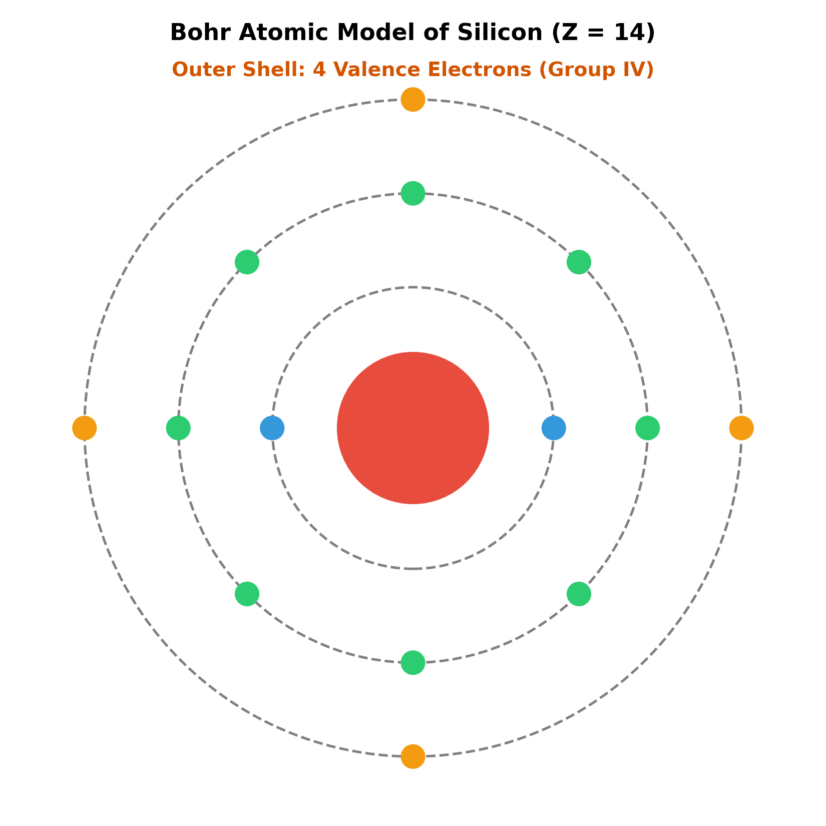
AEN 214: INTRODUCTION TO ELECTRONICS
Solid-State Semiconductors in Modern Agriculture
• Transition from Mechanical to Electronic: Solid-state physics powers all agricultural transducers, ECUs, and solar converters.
• Harsh Agro-Climatic Reality: Silicon chips in tractors operate from morning chill (15°C) to engine block heat (> 90°C).
• Intrinsic Carrier Runaway: Thermal carrier generation at elevated temperatures threatens sensor accuracy and bias stability.
• Tough Soil-Engaging Sensors: Hall effect magnetic sensors detect shaft rotation through mud, dust, and slurry where optics fail.
• Solar Photovoltaic Generation: The PN junction is the fundamental physical building block converting Tanzanian sunlight into pumping power.
Sokoine University of Agriculture | School of Engineering & Technology | Department of Agricultural Engineering
Slide 3 of 26

Slide 4
AEN 214: INTRODUCTION TO ELECTRONICS
The Silicon Atom & Covalent Crystal Lattice
• Atomic Structure: Silicon (Si, atomic number Z = 14); Electron configuration 1s² 2s² 2p⁶ 3s² 3p².
• Valence Shell: Four electrons in the outermost n=3 shell dictate semiconductor chemical and electrical properties.
• Diamond Cubic Crystal: In crystalline silicon, each atom forms four shared covalent bonds with adjacent silicon atoms.
• Thermal Equilibrium at 0 Kelvin: Every valence electron is tightly locked in covalent bonds; silicon behaves as a perfect insulator.
• Thermal Lattice Vibrations: At room temperature (T = 300 K), thermal energy breaks bonds, generating free electron-hole pairs.
Sokoine University of Agriculture | School of Engineering & Technology | Department of Agricultural Engineering
Slide 4 of 26

Slide 5
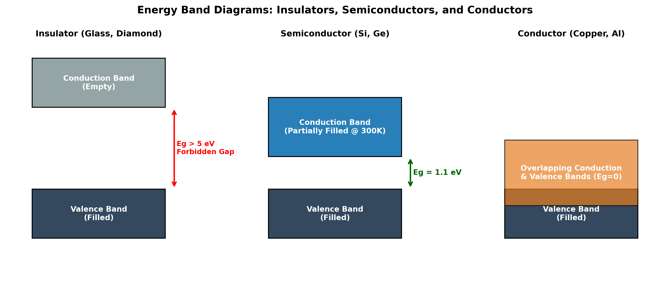
AEN 214: INTRODUCTION TO ELECTRONICS
Energy Band Formation in Solid-State Materials
• Pauli Exclusion Principle: When N isolated silicon atoms assemble into a crystal, discrete atomic levels split into continuous bands.
• Valence Band (VB): The lower energy band filled with valence bonding electrons at ground state.
• Conduction Band (CB): The higher energy band containing quasi-free mobile electrons that conduct electric current.
• Forbidden Energy Gap (E_g): The energy difference between the top of the VB (E_V) and the bottom of the CB (E_C).
• Electron-Volt (eV): Energy gained by an electron accelerating across 1 Volt potential: 1 eV = 1.602 x 10^-19 Joules.
Sokoine University of Agriculture | School of Engineering & Technology | Department of Agricultural Engineering
Slide 5 of 26

Slide 6
AEN 214: INTRODUCTION TO ELECTRONICS
Classification of Materials by Bandgap Energy
• Insulators: Wide forbidden gap (E_g > 5 eV, e.g. Diamond, SiO2); thermal energy at 300K cannot excite valence electrons across gap.
• Conductors (Metals): Conduction and valence bands overlap (E_g = 0 eV, e.g. Copper, Aluminum); vast sea of free electrons (10^28 m^-3).
• Semiconductors: Moderate forbidden gap (E_g ≈ 1.12 eV for Si, 0.67 eV for Ge, 1.42 eV for GaAs); controllable thermal excitation.
• Temperature Coefficient of Resistance: Metals possess positive TCR (resistance increases with heat); semiconductors have negative TCR.
• Silicon Dominance: Silicon's wider bandgap (1.12 eV vs 0.67 eV Ge) allows higher temperature operation (up to 150°C vs 75°C Ge).
Sokoine University of Agriculture | School of Engineering & Technology | Department of Agricultural Engineering
Slide 6 of 26

Slide 7
AEN 214: INTRODUCTION TO ELECTRONICS
Intrinsic Semiconductors & Carrier Generation
• Intrinsic Semiconductor: Pure, ultra-refined crystal with negligible impurity atoms (< 1 part per billion).
• Thermal Generation: Thermal agitation kicks an electron from the VB to the CB, leaving behind a vacant covalent state called a **Hole**.
• Hole Dynamics: An adjacent valence electron hops into the vacancy; the hole behaves physically as an effective mobile charge +q.
• Intrinsic Carrier Concentration (n_i): In pure silicon at 300 K, n_i = p_i ≈ 1.5 x 10^10 cm^-3 (or 1.5 x 10^16 m^-3).
• Temperature Sensitivity: n_i(T) = B · T^(3/2) · exp[-E_g / (2 · k_B · T)]; n_i doubles roughly every 8°C rise in temperature!
Sokoine University of Agriculture | School of Engineering & Technology | Department of Agricultural Engineering
Slide 7 of 26

Slide 8
AEN 214: INTRODUCTION TO ELECTRONICS
Extrinsic Doping: N-Type Semiconductor Physics
• Doping Purpose: Introducing controlled impurity atoms to increase electrical conductivity by up to six orders of magnitude.
• N-Type Dopants: Group V pentavalent elements (Phosphorus [P], Arsenic [As], Antimony [Sb]).
• Conduction Mechanism: Four valence electrons bond with silicon; the fifth electron is weakly bound (ionization energy ≈ 0.045 eV).
• Donor Energy Level (E_D): Lies just 0.045 eV below the conduction band edge E_C; virtually all donors ionize at room temperature.
• Carrier Densities: Majority carriers are electrons (n ≈ N_D); minority carriers are holes (p = n_i² / N_D). Fixed ions are N_D⁺.
Sokoine University of Agriculture | School of Engineering & Technology | Department of Agricultural Engineering
Slide 8 of 26

Slide 9
AEN 214: INTRODUCTION TO ELECTRONICS
Extrinsic Doping: P-Type Semiconductor Physics
• P-Type Dopants: Group III trivalent elements (Boron [B], Gallium [Ga], Indium [In]).
• Conduction Mechanism: Three valence electrons bond with adjacent silicon atoms, leaving one incomplete bond (a vacant hole).
• Acceptor Energy Level (E_A): Lies just 0.045 eV above the valence band edge E_V; captures valence electrons easily.
• Thermal Ionization: Valence electrons hop into acceptor levels, creating mobile holes in the valence band and fixed negative ions N_A⁻.
• Carrier Densities: Majority carriers are holes (p ≈ N_A); minority carriers are electrons (n = n_i² / N_A).
Sokoine University of Agriculture | School of Engineering & Technology | Department of Agricultural Engineering
Slide 9 of 26

Slide 10
AEN 214: INTRODUCTION TO ELECTRONICS
The Law of Mass Action & Electrical Conductivity
• Law of Mass Action: In thermal equilibrium, the product of electron and hole concentrations is constant: n · p = n_i²(T).
• Physical Significance: Increasing donor doping N_D increases electron density n and drastically suppresses hole density p.
• Drift Conductivity Equation: Total electrical conductivity sigma = q · (n · mu_n + p · mu_p) (Siemens/meter or (Ohm·m)^-1).
• Mobility Disparity: Electron mobility mu_n (≈ 1,350 cm²/V·s) is roughly 2.8 times higher than hole mobility mu_p (≈ 480 cm²/V·s).
• Resistivity Formulation: Electrical resistivity rho = 1 / sigma = 1 / [ q · (n · mu_n + p · mu_p) ].
Sokoine University of Agriculture | School of Engineering & Technology | Department of Agricultural Engineering
Slide 10 of 26

Slide 11
AEN 214: INTRODUCTION TO ELECTRONICS
Carrier Transport Mechanisms: Drift & Diffusion
• Drift Current: Charge carrier motion driven by an applied electric field E: J_drift = q(n·mu_n + p·mu_p) · E.
• Diffusion Current: Charge carrier motion driven by spatial concentration gradients (from high to low density regions).
• Fick's Law of Diffusion: J_diff,n = q · D_n · (dn / dx); J_diff,p = -q · D_p · (dp / dx), where D is diffusion coefficient (cm²/s).
• Einstein Relation: Connects thermal diffusivity to electrical mobility: D_n / mu_n = D_p / mu_p = V_T = (k_B · T) / q.
• Thermal Voltage (V_T): At room temperature T = 300 K, V_T = (1.38 x 10^-23 · 300) / (1.602 x 10^-19) ≈ 25.86 mV (standard 26 mV).
Sokoine University of Agriculture | School of Engineering & Technology | Department of Agricultural Engineering
Slide 11 of 26

Slide 12
AEN 214: INTRODUCTION TO ELECTRONICS
Worked Engineering Example 1: Extrinsic Doping & Law of Mass Action in Farm Silicon
PROBLEM SPECIFICATION & AGRICULTURAL CONTEXT:
A silicon substrate for an agricultural microcontroller ADC is uniformly doped with Phosphorus donor atoms at N_D = 2.0 x 10^16 cm^-3 at room temperature (T = 300 K, n_i = 1.5 x 10^10 cm^-3). Assume electron mobility mu_n = 1,250 cm²/V·s and hole mobility mu_p = 450 cm²/V·s. Calculate: (a) Majority carrier concentration n, (b) Minority carrier concentration p, (c) Electrical conductivity sigma.
STEP-BY-STEP MATHEMATICAL SOLUTION & VERIFICATION:
1. Majority Carrier Density: Since N_D >> n_i, full donor ionization occurs: n ≈ N_D = 2.0 x 10^16 cm^-3.
2. Minority Carrier Density via Mass Action: n · p = n_i² -> p = n_i² / n = (1.5 x 10^10)² / (2.0 x 10^16) = (2.25 x 10^20) / (2.0 x 10^16) = 1.125 x 10^4 cm^-3.
3. Note the Enormous Disparity: Majority electrons outnumber minority holes by a factor of 1.78 x 10^12!
4. Electrical Conductivity Formulation: sigma = q · (n · mu_n + p · mu_p) ≈ q · n · mu_n (minority holes contribute negligibly).
5. Calculate: sigma = (1.602 x 10^-19 C) · (2.0 x 10^16 cm^-3) · (1,250 cm²/V·s) = 4.005 (Ohm·cm)^-1 = 400.5 S/m. (Resistivity rho = 1/sigma = 0.25 Ohm·cm).
Sokoine University of Agriculture | School of Engineering & Technology | Department of Agricultural Engineering
Slide 12 of 26

Slide 13
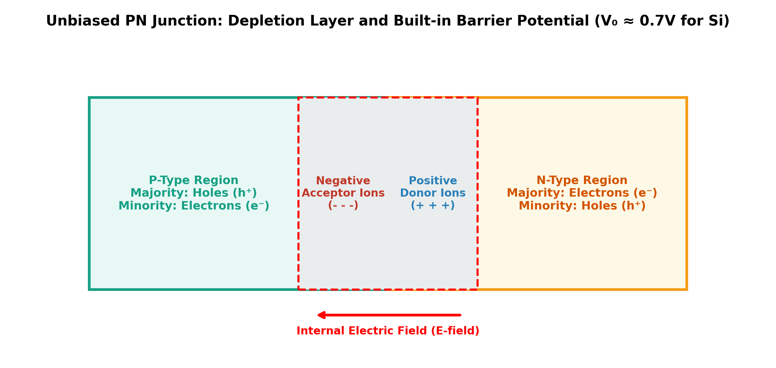
AEN 214: INTRODUCTION TO ELECTRONICS
The PN Junction: Space Charge Depletion Region
• Junction Formation: Joining P-type and N-type silicon creates steep carrier concentration gradients across the metallurgical boundary.
• Carrier Diffusion: Free electrons diffuse from N into P; mobile holes diffuse from P into N, recombining at the interface.
• Uncompensated Fixed Ions: Electron departure leaves positively charged donor cores (N_D⁺) on the N-side; hole departure leaves N_A⁻ on P-side.
• Space Charge Region (Depletion Layer): Region completely depleted of mobile charge carriers; contains only uncompensated bound ions.
• Internal Electric Field: Points from positive donor ions (N-side) to negative acceptor ions (P-side), halting further diffusion.
Sokoine University of Agriculture | School of Engineering & Technology | Department of Agricultural Engineering
Slide 13 of 26

Slide 14
AEN 214: INTRODUCTION TO ELECTRONICS
Built-in Barrier Potential V_0 & Energy Bands
• Built-in Potential Equation: V_0 = V_T · ln[ (N_A · N_D) / n_i² ], where V_T = k_B · T / q is the thermal voltage.
• Typical Silicon Values: For standard doping levels (10^16 to 10^17 cm^-3), V_0 ranges between 0.65 V and 0.75 V at 300 K.
• Energy Band Bending: In equilibrium, Fermi levels (E_F) align flat across the junction; conduction and valence bands bend by q·V_0.
• Potential Hill: Electrons in N-side conduction band face an energy barrier of q·V_0 preventing transit into the P-side.
• Contact Potential Measurement: V_0 cannot be measured with an ordinary voltmeter because contact potentials at probe leads cancel it.
Sokoine University of Agriculture | School of Engineering & Technology | Department of Agricultural Engineering
Slide 14 of 26

Slide 15
AEN 214: INTRODUCTION TO ELECTRONICS
Biased PN Junction: Forward & Reverse Regimes
• Forward Bias (V_ext > 0 on P, negative on N): Opposes internal E-field; reduces barrier height from V_0 to (V_0 - V_ext).
• Depletion Layer Thinning: Allows massive exponential injection of majority electrons across into P and holes into N.
• Reverse Bias (V_ext < 0 on P, positive on N): Aids internal E-field; increases barrier height to (V_0 + |V_R|).
• Depletion Layer Widening: Space charge width widens: W_dep proportional to sqrt(V_0 + |V_R|); halts majority diffusion.
• Reverse Saturation Current (I_S): Thermally generated minority carriers swept across junction by field; minuscule (pA to nA).
Sokoine University of Agriculture | School of Engineering & Technology | Department of Agricultural Engineering
Slide 15 of 26

Slide 16
AEN 214: INTRODUCTION TO ELECTRONICS
Reverse Breakdown: Zener Tunneling vs Avalanche
• Breakdown Phenomenon: When reverse voltage exceeds V_BR, reverse current increases abruptly without destruction if current is limited.
• Zener Breakdown Mechanism: Occurs in heavily doped junctions (V_BR < 5V); narrow depletion layer (< 10 nm) produces intense E-field (> 10^6 V/m).
• Quantum Mechanical Tunneling: Valence electrons tunnel directly through the thin barrier into the conduction band; negative temp coefficient.
• Avalanche Breakdown Mechanism: Occurs in lightly doped junctions (V_BR > 6V); wider depletion layer allows carriers to accelerate.
• Impact Ionization: Fast carriers collide with crystal lattice atoms, knocking loose new electron-hole pairs in chain reaction; positive temp coefficient.
Sokoine University of Agriculture | School of Engineering & Technology | Department of Agricultural Engineering
Slide 16 of 26

Slide 17
AEN 214: INTRODUCTION TO ELECTRONICS
Worked Engineering Example 2: Calculation of Built-in Barrier Potential V_0
PROBLEM SPECIFICATION & AGRICULTURAL CONTEXT:
A silicon PN junction diode manufactured for an automated tractor alternator regulator has acceptor doping N_A = 5.0 x 10^16 cm^-3 on the P-side and donor doping N_D = 1.0 x 10^16 cm^-3 on the N-side. Operating in a hot engine bay at T = 350 K, intrinsic concentration rises to n_i = 4.0 x 10^11 cm^-3. Calculate: (a) Thermal voltage V_T at 350 K, (b) Built-in potential V_0 at 350 K, (c) Compare with V_0 at 300 K (where n_i = 1.5 x 10^10 cm^-3, V_T = 25.86 mV).
STEP-BY-STEP MATHEMATICAL SOLUTION & VERIFICATION:
1. Thermal Voltage at 350 K: V_T = (k_B · T) / q = (1.3806 x 10^-23 J/K · 350 K) / (1.602 x 10^-19 C) = 0.03016 V = 30.16 mV.
2. Built-in Potential at 350 K: V_0 = V_T · ln[ (N_A · N_D) / n_i² ].
Ratio = (5.0 x 10^16 · 1.0 x 10^16) / (4.0 x 10^11)² = (5.0 x 10^32) / (1.6 x 10^23) = 3.125 x 10^9.
ln(3.125 x 10^9) = 21.863 -> V_0(350 K) = 0.03016 V · 21.863 = 0.6594 V (659.4 mV).
3. Compare at 300 K: Ratio = (5.0 x 10^32) / (1.5 x 10^10)² = 2.222 x 10^12 -> ln(2.222 x 10^12) = 28.429.
V_0(300 K) = 0.02586 V · 28.429 = 0.7352 V (735.2 mV).
4. Temperature Effect: V_0 decreases by ~75.8 mV as temperature rises by 50°C (rate ≈ -1.5 mV/°C due to exponential surge in n_i).
Sokoine University of Agriculture | School of Engineering & Technology | Department of Agricultural Engineering
Slide 17 of 26

Slide 18
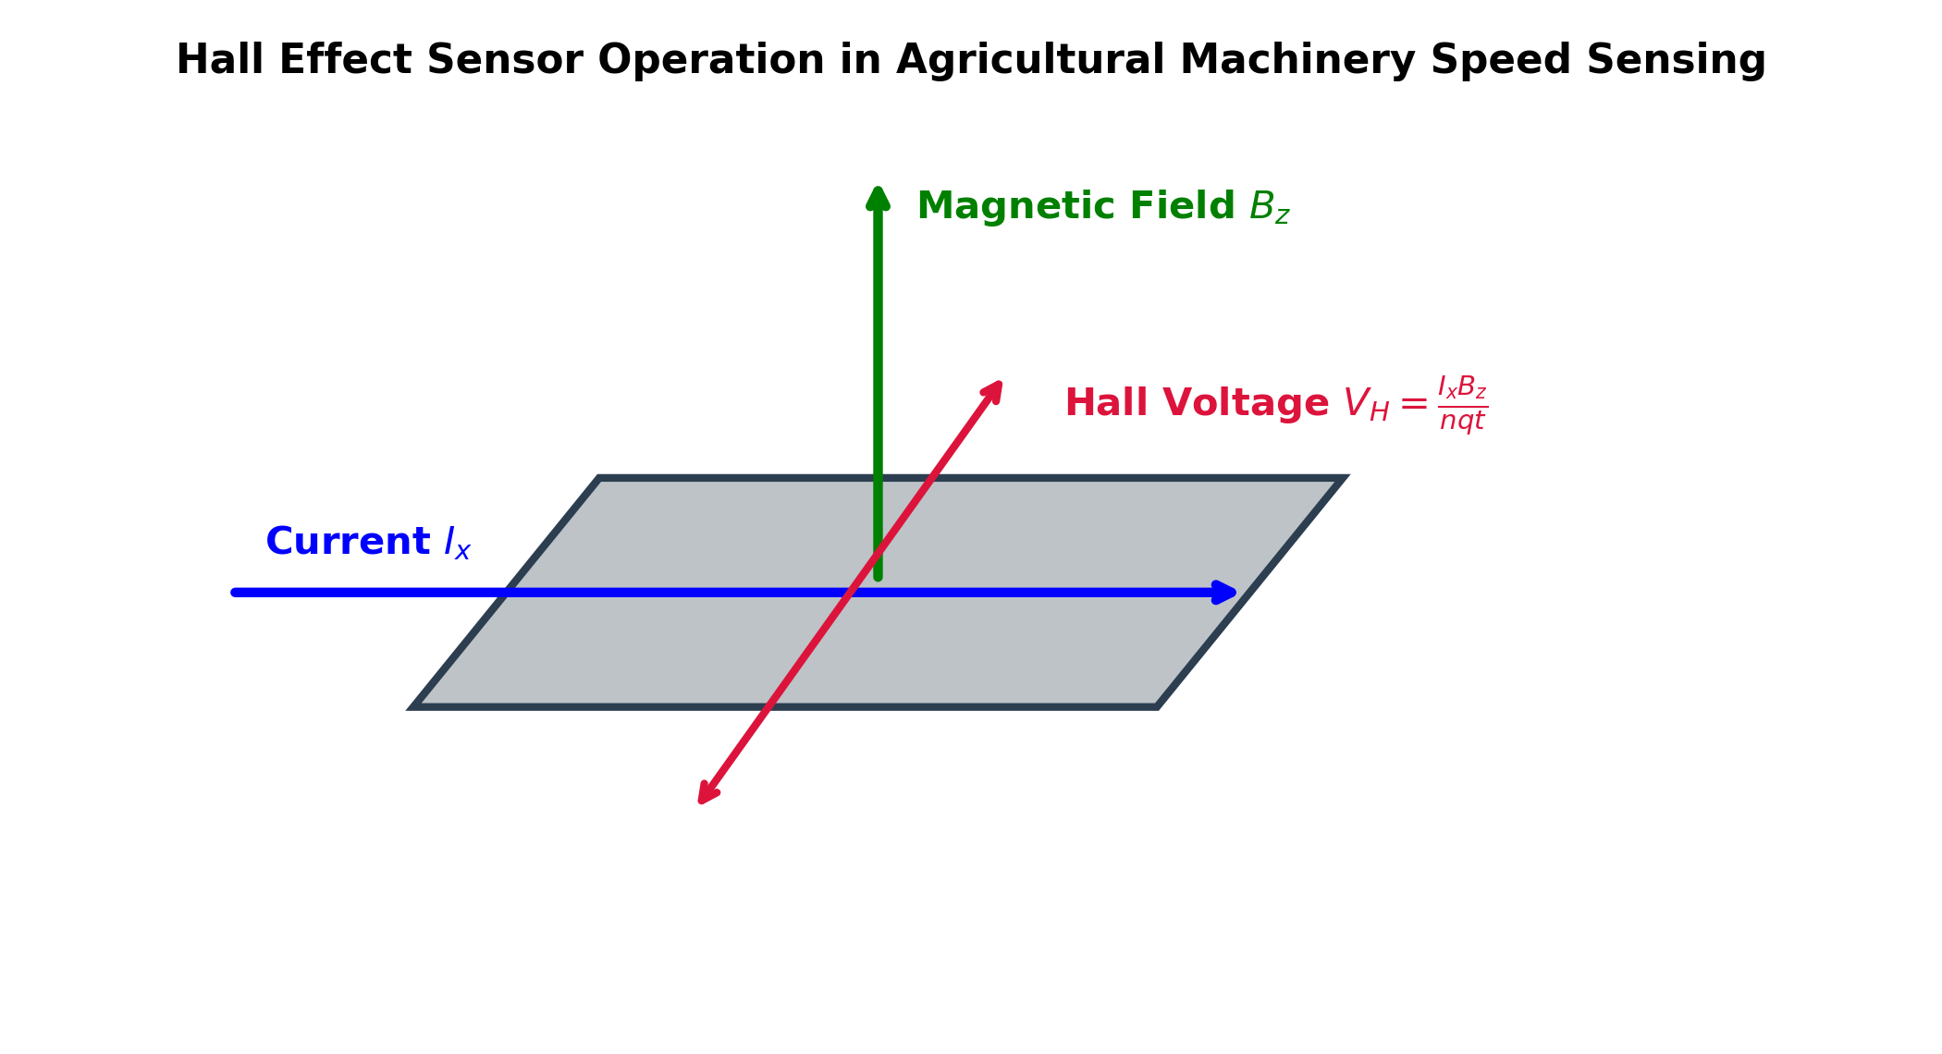
AEN 214: INTRODUCTION TO ELECTRONICS
The Hall Effect: Magnetohydrodynamic Physics
• Lorentz Force Principle: A moving charge q in perpendicular electric (E) and magnetic (B) fields experiences force F = q(E + v x B).
• Charge Deflection: Current I_x flows along x-axis; perpendicular magnetic field B_z exerts transverse Lorentz force F_y = q · v_x · B_z.
• Hall Electric Field (E_H): Deflected charges pile up on lateral faces, building transverse field E_H that exactly counterbalances magnetic force.
• Hall Voltage Equation: V_H = E_H · w = (I_x · B_z) / (n · q · t) = R_H · (I_x · B_z) / t, where t is semiconductor thickness.
• Hall Coefficient: R_H = 1 / (n · q) for electrons; inversely proportional to carrier concentration n (semiconductors produce large V_H!).
Sokoine University of Agriculture | School of Engineering & Technology | Department of Agricultural Engineering
Slide 18 of 26

Slide 19
AEN 214: INTRODUCTION TO ELECTRONICS
Hall Effect Sensors in Agricultural Machinery
• PTO Shaft Tachometers: Senses passing teeth of tractor power-take-off gear; immune to dust, flying chaff, and grease.
• Combine Harvester Threshing Cylinder Monitoring: Detects shaft speed drop indicating drum slugging or belt slippage before jamming.
• True Ground Speed Radar & Wheel Encoders: Measures wheel revolutions to calculate slip percentage in muddy paddy cultivation.
• Brushless DC (BLDC) Motor Commutation: Senses rotor permanent magnet position to time stator phases in agricultural drone sprayers.
• Non-Contact Current Sensing: Measures magnetic field surrounding heavy solar pump cables without physical electrical contact.
Sokoine University of Agriculture | School of Engineering & Technology | Department of Agricultural Engineering
Slide 19 of 26

Slide 20
AEN 214: INTRODUCTION TO ELECTRONICS
Worked Engineering Example 3: Tractor PTO Shaft Hall Effect Speed Sensor
PROBLEM SPECIFICATION & AGRICULTURAL CONTEXT:
A Hall effect transducer is mounted on a Massey Ferguson tractor PTO gearbox to detect gear tooth passage. The semiconductor sensor slice is N-type silicon with thickness t = 0.50 mm and donor carrier density n = 1.0 x 10^15 cm^-3 (1.0 x 10^21 m^-3). A control current I_x = 10.0 mA flows through the sensor. A neodymium target magnet attached to the PTO shaft applies a peak field B_z = 0.35 Tesla. Calculate: (a) Hall coefficient R_H, (b) Peak Hall voltage V_H generated, (c) Frequency of V_H pulses if the PTO rotates at 540 RPM and the sensor monitors a 12-tooth gear.
STEP-BY-STEP MATHEMATICAL SOLUTION & VERIFICATION:
1. Hall Coefficient: R_H = -1 / (n · q) = -1 / (1.0 x 10^21 m^-3 · 1.602 x 10^-19 C) = -6.242 x 10^-3 m³/C.
2. Calculate Hall Voltage: V_H = (I_x · B_z) / (n · q · t) = |R_H| · (I_x · B_z) / t.
Substitute: I_x = 10.0 x 10^-3 A; B_z = 0.35 T; t = 0.50 x 10^-3 m.
V_H = (6.242 x 10^-3 m³/C · 0.010 A · 0.35 T) / (0.50 x 10^-3 m) = (2.185 x 10^-5) / (5.0 x 10^-4) = 0.0437 V = 43.7 mV.
3. Pulse Frequency at 540 RPM: Shaft speed f_shaft = 540 rev / 60 s = 9.0 rev/second (9.0 Hz).
With a 12-tooth target gear: Pulse frequency f_pulse = 9.0 Hz · 12 teeth = 108.0 Hz.
4. System Integration: The 43.7 mV, 108 Hz sinusoidal pulse train is amplified and squared by a comparator into a 5V digital signal.
Sokoine University of Agriculture | School of Engineering & Technology | Department of Agricultural Engineering
Slide 20 of 26

Slide 21
AEN 214: INTRODUCTION TO ELECTRONICS
Tanzanian Field Case Study 1: Hall Sensor Threshing Cylinder Jam Protection
FIELD LOCATION & PROBLEM IDENTIFICATION
• Geographic Location: Kilombero Valley Teak & Rice Basin, Morogoro, Tanzania
During peak wet-season paddy harvesting, combine harvesters frequently suffered threshing drum slugging when heavy, damp rice straw choked the concave. Slipping drive belts burned out in under 90 seconds before operators noticed engine pitch changes, costing 3,200 USD per breakdown.
SUA ENGINEERING SOLUTION & AGRONOMIC IMPACT
SUA mechatronics engineers installed a rugged hermetic Hall effect speed transducer on the secondary threshing shaft, pairing it with a 16-tooth ferrous target ring. A microcontroller compares engine RPM with threshing drum RPM every 50 ms. If drum slip exceeds 8%, an automated electro-hydraulic clutch disengages the header and sounds a high-decibel alarm within 120 ms.
Measurable Performance Metrics:
✔ Completely eliminated burnt drive belts and cylinder drum jams across 4 harvesting seasons.
✔ Automated disengagement response time reduced from > 15 seconds (human) to 120 ms.
✔ Saved an estimated 28,000 USD in downtime and mechanical repairs across 6 harvesters.
Sokoine University of Agriculture | School of Engineering & Technology | Department of Agricultural Engineering
Slide 21 of 26

Slide 22
AEN 214: INTRODUCTION TO ELECTRONICS
Tanzanian Field Case Study 2: Solar Well Pump Inverter Thermal Runaway Mitigated
FIELD LOCATION & PROBLEM IDENTIFICATION
• Geographic Location: Bahi Wetland & Solar Borehole Project, Dodoma Region, Tanzania
In semi-arid Dodoma, solar photovoltaic borehole pumping systems operated in ambient temperatures exceeding 43°C. The central inverter junction boxes mounted directly beneath solar panels frequently suffered semiconductor diode and transistor latch-up failures between 12:00 PM and 2:30 PM.
SUA ENGINEERING SOLUTION & AGRONOMIC IMPACT
Thermal analysis revealed that internal junction temperatures were surpassing 145°C. At this temperature, intrinsic carrier generation n_i surged by a factor of 85, collapsing reverse breakdown voltage and creating thermal carrier leakage runaway. Engineers retrofitted the enclosures with thermal chimney solar shields and upsized the silicon heat sinks.
Measurable Performance Metrics:
✔ Junction operating temperature dropped from 148°C to a safe 82°C under peak insolation.
✔ Pumping uptime restored to 100%, delivering 65,000 liters/day of irrigation water.
✔ Extended estimated power semiconductor MTBF from 6 months to over 7 years.
Sokoine University of Agriculture | School of Engineering & Technology | Department of Agricultural Engineering
Slide 22 of 26

Slide 23
AEN 214: INTRODUCTION TO ELECTRONICS
Laboratory Bench Protocol: Semiconductor Diode & Hall Sensor Bench Characterization
PRACTICAL LAB LEARNING OUTCOMES & BENCH REQUIREMENTS:
• Measure silicon and germanium PN junction barrier voltages using curve tracer / bench supply.
• Determine the temperature coefficient of built-in barrier voltage Delta V / Delta T.
• Observe reverse breakdown characteristics on high-voltage test supply.
• Calibrate a Hall effect sensor module against known magnetic fields and gear rotation.
STEP-BY-STEP PROTOTYPING & DIAGNOSTIC PROCEDURE:
Step 1: Wire 1N4007 (Si) and 1N34A (Ge) diodes on breadboard with 1 kOhm current-limiting resistor.
Step 2: Sweep DC supply from 0.0V to 1.5V; log diode voltage V_D and current I_D on digital multimeters.
Step 3: Plot forward I-V curve; extract knee barrier voltage (V_knee ≈ 0.65V for Si, 0.28V for Ge).
Step 4: Immerse diode in controlled hot-water bath (30°C to 70°C); record V_D at fixed I_D = 1.0 mA; compute -2.1 mV/°C slope.
Step 5: Mount Hall sensor module (UGN3503) adjacent to motorized gear wheel; connect DSO; verify pulse amplitude vs gap distance.
Sokoine University of Agriculture | School of Engineering & Technology | Department of Agricultural Engineering
Slide 23 of 26

Slide 24
AEN 214: INTRODUCTION TO ELECTRONICS
Lecture 2 Self-Assessment & Upcoming Topics
SELF-ASSESSMENT & PROBLEM-SOLVING EXERCISES:
Q: Explain why intrinsic silicon behaves as an insulator at 0 Kelvin but conducts electricity at room temperature (300 K).
Q: State the Law of Mass Action. If silicon is doped with 10^17 cm^-3 Boron atoms, what is the minority electron density?
Q: Derive the equation for the built-in barrier potential V_0 of a PN junction and explain its temperature dependence.
Q: Contrast Zener breakdown and Avalanche breakdown in terms of doping concentration and temperature coefficients.
Q: Explain the physical principle of the Hall effect and write the equation for the generated Hall voltage V_H.
NEXT LECTURE PREVIEW & REQUIRED PREPARATION:
Lecture 3 will explore Semiconductor Diodes & Applications: Shockley equation, dynamic resistance, rectification, and clippers/clampers.
Sokoine University of Agriculture | School of Engineering & Technology | Department of Agricultural Engineering
Slide 24 of 26

Slide 25
AEN 214: INTRODUCTION TO ELECTRONICS
Lecture 2 Synthesis: Key Takeaways & Formula Sheet
CORE CONCEPTUAL TAKEAWAYS
✔ Semiconductor electrical behavior is governed by energy bandgap E_g (1.12 eV for Si at 300 K).
✔ Extrinsic doping (N-type donors, P-type acceptors) increases carrier density and conductivity by millions of times.
✔ In thermal equilibrium, the Law of Mass Action (n · p = n_i²) holds strictly constant across all doping levels.
✔ The PN junction depletion region creates a built-in barrier potential V_0 ≈ 0.7 V for Si (decreases by ~2 mV/°C).
✔ The Hall effect provides rugged, non-contact magnetic speed and position sensing immune to agricultural grime.
CRITICAL ENGINEERING FORMULAS
★ Mass Action: n · p = n_i²(T)
★ Conductivity: sigma = q(n·mu_n + p·mu_p); rho = 1/sigma
★ Einstein Relation: D / mu = V_T = k_B · T / q ≈ 26 mV
★ Built-in Potential: V_0 = V_T · ln[ (N_A · N_D) / n_i² ]
★ Depletion Width: W_dep proportional to sqrt(V_0 + V_R)
★ Hall Voltage: V_H = (I_x · B_z) / (n · q · t) = R_H · (I_x · B_z) / t
★ Hall Coefficient: R_H = 1 / (n · q)
Sokoine University of Agriculture | School of Engineering & Technology | Department of Agricultural Engineering
Slide 25 of 26

Slide 26
AEN 214: INTRODUCTION TO ELECTRONICS
Prescribed References & Practical Laboratory Preparation
• Streetman, B. G., & Banerjee, S. (2016). Solid State Electronic Devices (7th ed.). Pearson.
• Sedra, A. S., & Smith, K. C. (2020). Microelectronic Circuits (8th ed.). Oxford University Press.
• Boylestad, R. L., & Nashelsky, L. (2018). Electronic Devices and Circuit Theory (11th ed.). Pearson Education.
• Laboratory Preparation: Review semiconductor diode safety procedures and wear ESD wrist straps during Lab Session 2.
• Field Assignment: Complete Assignment 1, Questions 5 to 8 on semiconductor physics and submit via SUA LMS.
Sokoine University of Agriculture | School of Engineering & Technology | Department of Agricultural Engineering
Slide 26 of 26

